Slide 1
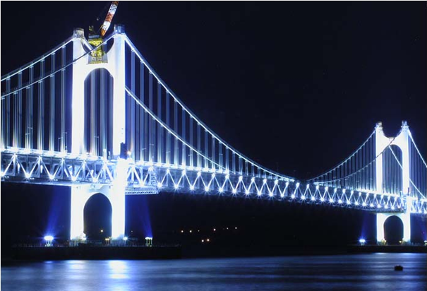




Bridging the Gap
3rd Covergence Research Symposium; Redesigning of
Cancer Imaging and Therapy
일시: 2011 년 11월 28일 (월) 오후 2시 ~ 5시 30분
장소: 종합관 211호
11. 28 (Mon) | Program
Session I. Targeted MR Imaging for Diagnosis of Cancer (좌장: 조은진)
14:00 ~ 14:30 |  | Session I-1 (이택수): Targeted MR contrast agent
14:30 ~ 15:00 |  | Session I-2 (이훈재): MR molecular imaging
15:00 ~ 15:10 |  | Coffee break
Session II. Optical Imaging of Cancer (좌장: 최지혜)
15:10 ~ 15:40 |  | Session II-1 (장은지): Optical imaging based on fluorescence resonance energy transfer
15:40 ~ 16:10 |  | Session II-2 (정기영): THz pulsed imaging for biomedical application
16:10 ~ 16:20 |  | Coffee break
Session III. Organic Nanoplatform for Theragnosis of Cancer (좌장: 임은경)
16:20 ~ 16:50 |  | Session III-1 (김현욱): Polymersomes as a gene and drug delivery nanocarrier
16:50 ~ 17:20 |  | Session III-1 (박정민): CD44 targeting theragnosis
17:20 ~ 17:30 |  | Closing Ceremony (양재문)

